Slide 1

Superstore Business
Team
Ali Ghanem
Hajar Rashad Deraz
Omar Ahmed Wahby
Seif Salah Ahmed Mostafa
Mohanad Elkashir
Hossam Genedy
Date: May 2025

Slide 2

Problem of the Data
Fragmented Data
Regional performance metrics are dispersed and lack completeness.
Shipping Insights
Absence of a consolidated overview of shipping efficiency and delays.
Profitability Visibility
Limited transparency regarding product profitability.
Underutilized Customer Segmentation
Segmentation data is not effectively applied in marketing strategies.

Slide 3
Proposed Solutions
Data Dashboards
Profit Analysis
Predictive Modeling
Develop real-time, integrated dashboards to enhance decision-making capabilities.
Perform detailed profit analysis segmented by sub-category and customer demographics.
Leverage predictive models to identify product lines with the highest potential returns.
Shipping Optimization
Customer Profiling
Utilize historical shipping data and trends to streamline and improve delivery efficiency.
Create targeted marketing campaigns based on comprehensive customer profiles.

Slide 4





Business Overview
Revenue Growth
Sales Drivers
Low Sales Leaders
Steady annual growth observed across all regions.
Technology and Office Supplies are the leading contributors to Sales.
Office Supplies, particularly Appliances, remains the main loss category.
Key Segments
Big Sales
Strong focus on Consumer and Corporate customer segments.
Sales peak during the months of September and November.

Slide 5



Products & Sub-products
Main Categories
Top Sub-Categories
Furniture
Phones
Office Supplies
Chairs
Technology
Tables
Low Performers
Marketing Focus
Bundle Strategy
Appliances and bookcases are showing weaker sales performance.
Prioritize marketing efforts on high-margin sub-categories.
Consider bundling underperforming products with popular items to boost sales.

Slide 6



Location Insights
Top Regions
Underperforming Regions
The Western and Eastern regions continue to lead in overall performance metrics.
The Central and Southern regions are trailing behind in several key performance indicators.
City Leaders
Opportunities
Logistics Challenges
California, New York, and Texas generate the highest revenue streams.
Deploy targeted promotions to enhance performance in underperforming cities.
Delivery times remain lengthy in the Central United States, impacting operational efficiency.

Slide 7




Customer Segmentation
50%
30%
Consumer
Corporate
20%
Home Office
Loyalty Opportunity
High Value
The Home Office segment is currently under-targeted and presents growth potential.
Repeat purchases from the Corporate segment significantly drive value.
Marketing Focus
Focus on upselling Home Office products through strategic bundling.

Slide 8


Shipping Analysis
Shipping Modes
Delays & Costs
Standard
Longest delays occur with Second Class shipments in the Central region.
Second Class
First Class
Same day shipping is expensive and delivers low return on investment.
Same Day
Action Plan
Lead Time
Focus on prioritizing Standard shipping to balance cost and performance effectively.
The East region consistently achieves the fastest delivery cycles.

Slide 9
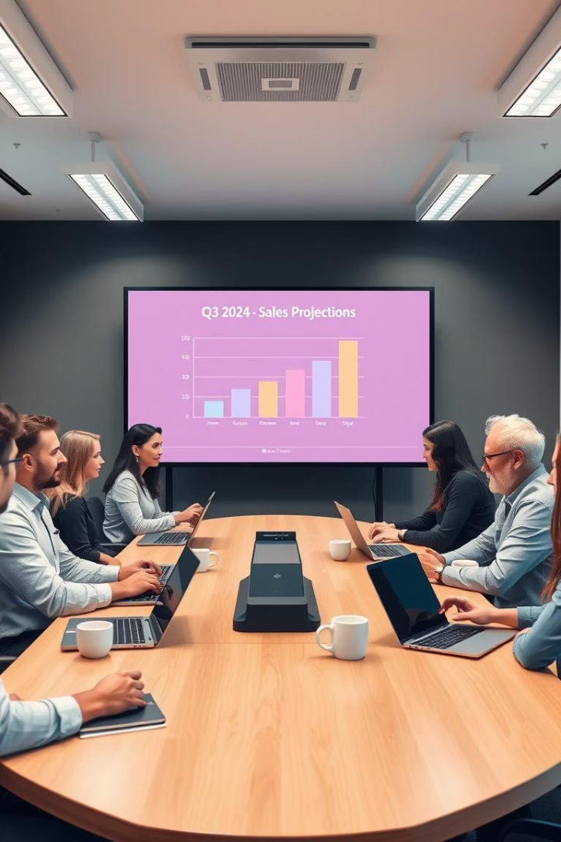




Summary & Strategic Recommendations
Optimize Inventory
Target marketing efforts by product category and customer segment for maximum impact.
Logistics Investment
Enhance delivery performance in the Central and South regions to improve efficiency.
Tailored Promotions
Develop customized promotions tailored to specific locations and customer types.
Predictive Analytics
Leverage forecasting to identify top-performing sub-categories and guide strategy.
1
Year-over-Year
2
Month-over-Month
Incorporate Year-over-Year comparisons to gain deeper insights and inform decision-making.
Incorporate Month-over-Month comparisons to gain deeper insights and inform decision-making.
3
Multi-year Average Order Value (AOV)
Incorporate multi-year AOV comparisons to gain deeper insights and inform decision-making.

Slide 10
Thank You

